Slide 1
BCOG 100
Language
Lecture 3: The Neuroscience of Language

Slide 2
Reading Check 11-3
Password: broca
Question: The article says all languages have a grammar. What does that mean?

Slide 3
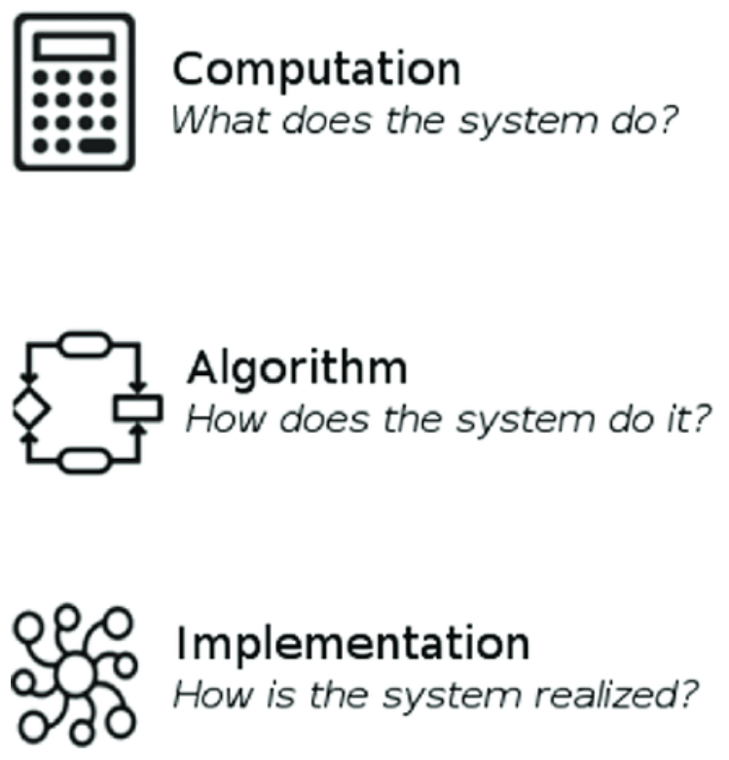
The Neuroscience of Language
Recap & Overview
Last Time:
The psychology of language, and the “rules vs. statistics” debate
Today:
From theories of mind to brain systems
What would each theory look like neurally?
Notes:
In Lecture 2 we asked how minds do language—rules, patterns, prediction, and social meaning.
Today we ask how those processes are realized in the brain’s circuits and timing.
We will map cognitive claims onto neural systems without assuming one grand theory wins.
The goal is constraint and clarity, not a final verdict.
If grammar is an internal rule system, we might expect specialized, selective regions.
If structure emerges from learning, we might expect distributed, adaptive networks.
If prediction drives comprehension, we should see anticipatory neural signals in time.
If social intention is central, language should interface with mindreading networks.
Each of these expectations is testable with different methods.
Functional imaging can localize where computations concentrate across the cortex.
ERPs and other time-resolved signals can reveal when processes unfold millisecond by millisecond.
Lesions and stimulation can show which components are necessary for which functions.
Throughout, we’ll keep the debate from Lecture 2 in view.
Neural evidence will support both specialization and plasticity in different ways.
Some findings will look “symbolic,” others unmistakably “learning-based.”
Our task is to integrate them into a coherent, multi-level picture.

Slide 4
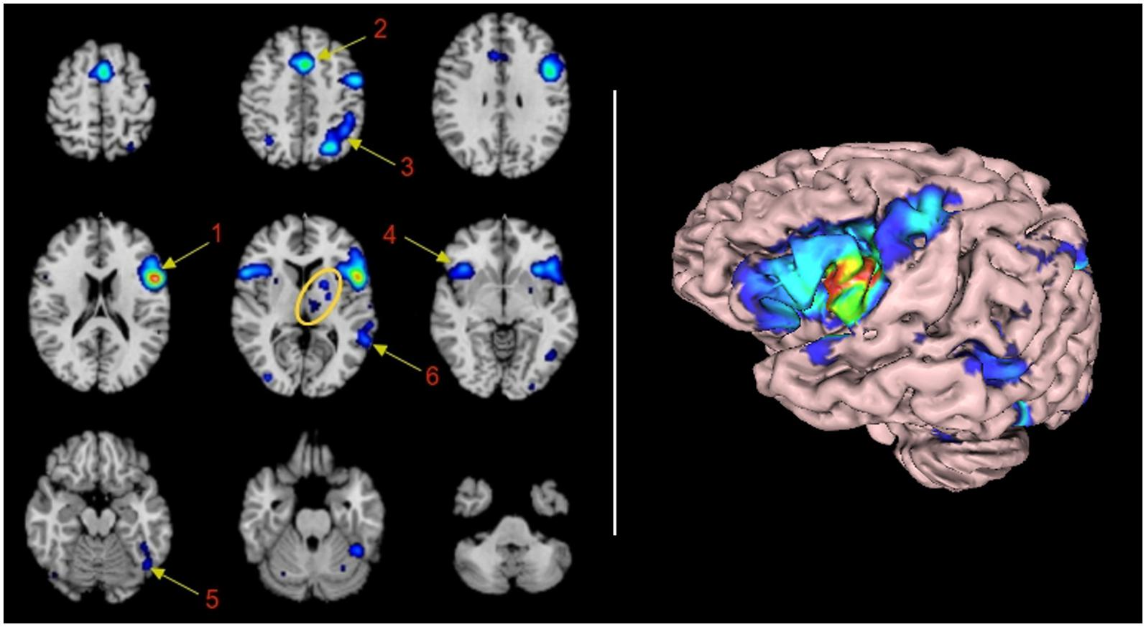
The Neuroscience of Language
What Neuroscience Adds, and Doesn’t
Brain data illuminate processes, not philosophies
Localization is not explanation
Implementation complements, not replaces, theory
Notes:
Neuroscience lets us watch language unfold in the brain’s hardware.
It reveals which areas light up when we speak, listen, or read
—and when those signals rise and fall over milliseconds.
Such evidence provides critical constraints: any cognitive theory
must be compatible with the physical system that carries it out.
But constraints are not the same as explanations.
The phrase “localization is not explanation” captures this caution.
Finding a region that activates during syntax or semantics
doesn’t mean the region is syntax or semantics.
It might support working memory, timing, or prediction—functions shared across domains.
Neural activity is the medium of cognition, not the theory of it.
Localization tells us where computations concentrate,
not what computations are being performed.
This distinction is crucial because it keeps levels of analysis aligned.
Marr’s implementational level describes the physical realization of processes
identified at the algorithmic level.
Confusing the two leads to category errors: mistaking anatomy for computation.
We don’t explain language by pointing to Broca’s area
any more than we explain gravity by pointing to a falling apple.
Neuroscience therefore complements, rather than replaces, cognitive theory.
Brain evidence can test whether symbolic and learning-based models
predict distinct spatial or temporal signatures.
It can show whether structure is fixed or plastic, and how neural timing
reflects rule-like or predictive processes.
The rest of this lecture will explore those questions
—seeing what the brain reveals, and what it leaves open.

Slide 5
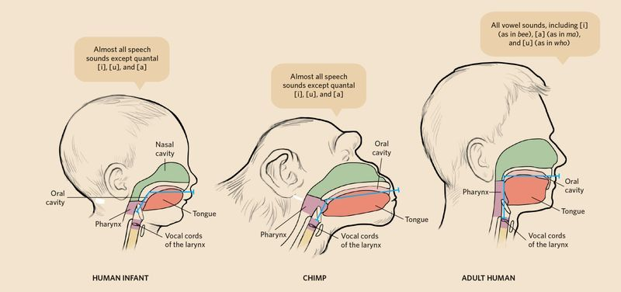
The Neuroscience of Language
Evolving the Vocal Tract
Speech depends on anatomy as well as thought
Small physical shifts, vast communicative payoffs
Evolution shaped how sound could carry meaning
Notes:
Before there was language in the mind, there had to be a body that could produce it.
Compared with other primates, humans have a unique vocal tract
—shorter oral cavity, longer pharynx, and a lowered larynx.
These changes allowed a wider range of resonant frequencies,
creating the distinct vowel system that speech relies on.
They also made breath control and articulation far more precise,
expanding the acoustic palette from grunts to phonemes.
These adaptations were gradual.
Early Homo species show partial lowering of the larynx,
while Neanderthals likely had nearly human vocal anatomy.
The reshaping of the tongue and mouth allowed flexible modulation of sound
without losing airway stability.
Meanwhile, the chest and diaphragm evolved finer voluntary control,
permitting long, modulated exhalations—critical for continuous speech.
Such modifications carried both costs and benefits.
A lower larynx increases the risk of choking, but the communicative payoff was enormous.
It let humans encode subtle differences in timing and pitch, enabling distinct words and prosody.
Speech became faster, more expressive, and more learnable than gesture or call systems alone.
The evolution of the vocal tract illustrates that language’s roots
are as physical as they are cognitive.
Changes in anatomy provided the raw materials for symbolic systems to arise.
Once the body could produce richly structured sound,
natural selection could begin tuning the brain to perceive and control it.
In the next slides, we’ll see how those neural and motor systems expanded to make language possible.

Slide 6
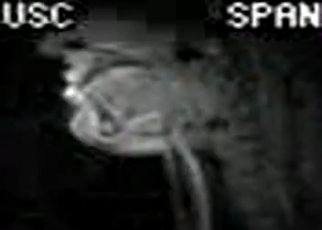
The Neuroscience of Language
Motor and Respiratory Control for Speech
Speaking is skilled movement, not just sound
Motor control made language fluid and flexible
The brain learned to choreograph breath, lips, and larynx
Notes:
The ability to speak required more than a new vocal tract
—it needed new control systems in the brain.
Humans show an expanded representation of the mouth, tongue, and larynx
in primary motor cortex, with finer corticobulbar connections to brainstem nuclei.
These direct pathways allow voluntary, rapid sequencing of articulatory gestures,
unlike the more reflexive vocalizations of other primates.
Speech became a learned, practiced skill—an act of motor precision shaped by experience.
Equally important was the coordination of breathing.
Speech depends on long, controlled exhalations that support
entire sentences on a single breath.
Neural loops connecting motor cortex, cerebellum, and the brainstem’s respiratory centers
evolved to manage this balance of pressure and timing.
These systems synchronize with auditory feedback, allowing continuous monitoring a
nd correction of sound production.
This expanded motor control blurs the line between speech and movement.
Neurons in premotor and supplementary motor areas fire
not only during speaking but also during silent rehearsal and lip reading.
Such overlap supports theories linking gesture and speech
—the idea that spoken language co-opted preexisting circuits
for manual communication and imitation.
Language, in this sense, is built on the same neural scaffolding as tool use and motor planning.
Together, these developments created the hardware for verbal expression.
Once the motor system could flexibly combine gestures, sounds, and breath,
cultural learning could shape those patterns into words.
Language may have started in the body’s movements,
but it was the brain’s new control over those movements that turned sound into syntax.
Next, we’ll look at evidence for how this system evolved across species.

Slide 7
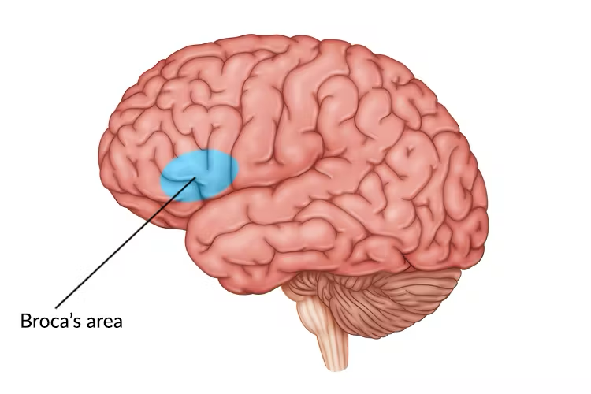
The Neuroscience of Language
Broca’s Discovery and Expressive Aphasia
Language and brain meet in a single patient
Speech lost, comprehension spared
Broca’s area and the birth of localization
Notes:
In 1861, the French physician Paul Broca presented the case of a man known as Tan,
nicknamed for the only syllable he could say.
Despite severe speech loss, Tan understood questions and could gesture appropriate answers.
After his death, Broca found a lesion in the left inferior frontal gyrus,
showing that specific damage could selectively impair speech production.
This was the first clear link between a mental faculty and a circumscribed brain region.
Broca soon identified several similar cases, all with left-hemisphere frontal damage.
He concluded that this region controlled the coordination of speech articulation
—the conversion of ideas into words.
In contrast, comprehension and general intelligence remained intact,
implying that “language” was not a single unified capacity.
The finding became a cornerstone of the idea that complex cognitive functions
could be localized in the cortex.
This condition became known as expressive aphasia, or Broca’s aphasia.
Speech is effortful, halting, and grammatically simplified,
though content words and meaning often survive.
Patients might say “Walk dog” or “Food home now,” revealing that they know
what they want to say but struggle to produce fluent syntax.
Such patterns inspired early models of grammar as a generative engine housed in the frontal lobe.
Broca’s discovery marks both a breakthrough and a cautionary tale.
It demonstrated that language depends on physical structures of the brain
—but not that a single region is language.
His work opened the path to modern neurolinguistics while also planting the seeds
for oversimplified maps we will revisit in the slides ahead.
Next, we turn to his contemporary, Carl Wernicke, who revealed the other side of this story.

Slide 8
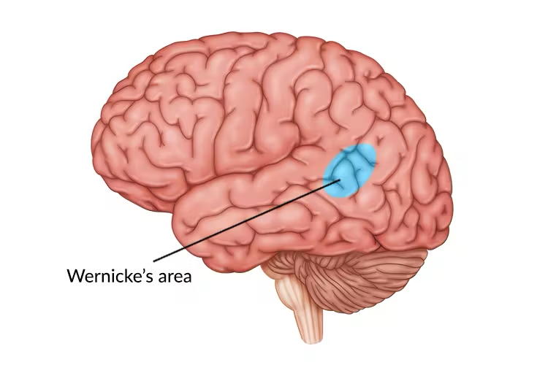
The Neuroscience of Language
Wernicke’s Discovery and Receptive Aphasia
Fluent speech, but meaning lost
Comprehension depends on posterior networks
Two halves of the classical language model emerge
Notes:
Just over a decade after Broca’s findings, Carl Wernicke described a complementary syndrome.
Some of his patients spoke easily and with normal prosody, but their sentences
were incoherent or filled with invented words.
They could not understand spoken or written language, though motor control of speech was intact.
Autopsies revealed damage in the posterior superior temporal gyrus,
a region near the auditory cortex of the left hemisphere.
Wernicke proposed that this area housed auditory word images
—the representations that link sound to meaning.
When this region is damaged, comprehension fails because incoming sounds
can’t be matched to stored lexical patterns.
He argued that Broca’s and Wernicke’s areas formed distinct but
connected components of the language system:
the anterior region for production and sequencing, the posterior for perception and understanding.
Together they established the idea of a fronto–temporal circuit for language.
Patients with receptive aphasia (or Wernicke’s aphasia) can produce long,
grammatically structured sentences that lack semantic coherence.
They might say “Yes, I’m fine, the dog is looking at the television with the foot of the mountain,”
unaware of the nonsensical content.
This dissociation between fluent form and broken meaning helped separate
the notions of syntax, semantics, and phonology in early cognitive models.
Wernicke’s discovery completed the first anatomical theory of language.
But like Broca’s, it was based on small samples and postmortem inference.
While it captured a real pattern—different lesions produce different linguistic deficits
—it also encouraged a misleadingly modular picture.
The next slide will show how these findings were assembled into a single, elegant,
and ultimately oversimplified model.

Slide 9
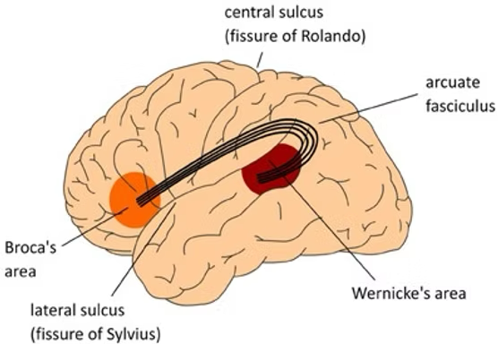
The Neuroscience of Language
The Classical Circuit: Broca ↔ Wernicke via Arcuate Fasciculus
A wiring diagram for language is born
Production and comprehension linked by a pathway
Simple, elegant—and incomplete
Notes:
Building on Broca’s and Wernicke’s discoveries, early neurologists proposed
a two-node model of language.
Broca’s area in the frontal lobe generated speech plans,
Wernicke’s area in the temporal lobe recognized and stored words,
and the arcuate fasciculus, a white-matter tract between them,
transmitted information from comprehension to production.
This model gave the first mechanistic sketch of how the brain
could connect understanding and speaking.
For decades, this “classical” circuit dominated theories of language in neuroscience and psychology.
It aligned neatly with the new idea of localization of function:
mental abilities mapped onto discrete cortical modules.
It also provided a diagnostic framework for clinical neurology
—different types of aphasia were traced to disconnections within this loop.
Even today, medical textbooks often present it as the canonical model of the language system.
The appeal of this diagram was its clarity.
Language, one of humanity’s most complex behaviors, was explained with just two centers
and a connecting wire.
It captured the observed double dissociation: patients with frontal damage lost production;
those with posterior damage lost comprehension.
But simplicity came at a cost—it ignored the broader brain networks that contribute to timing,
working memory, semantics, and feedback.
As new tools emerged—electrical stimulation, imaging, and lesion mapping
—the classical circuit began to look too narrow.
Speech and comprehension turned out to involve bilateral and subcortical contributions,
and communication between regions was dynamic, not one-way.
The initial tidy diagram gave way to a more complex and realistic view of language in the brain.

Slide 10
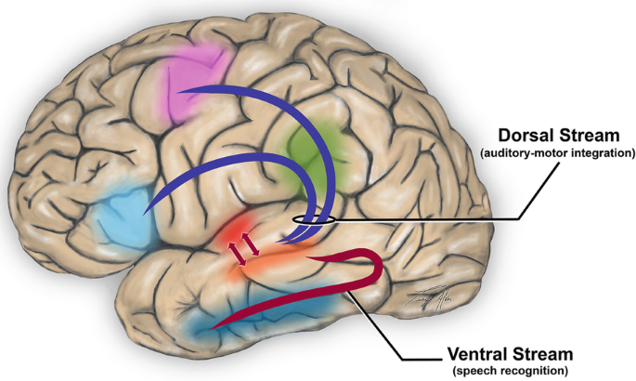
The Neuroscience of Language
Limits of the Classical Story
Two centers cannot explain a distributed skill
Language relies on loops, not lines
Modern models replace the circuit with interacting streams
Notes:
By the late 20th century, new tools—CT, MRI, fMRI, and lesion mapping
—revealed that language engages far more than Broca’s and Wernicke’s areas.
Lesions outside the classical circuit could still produce aphasia,
and some patients recovered speech despite severe damage to it.
Functional imaging showed broad activation across frontal, temporal, and parietal cortices,
as well as subcortical and cerebellar regions.
Language processing was not confined to two nodes but distributed across a large-scale network.
These discoveries led to Hickok and Poeppel’s dual-stream model,
now one of the most influential frameworks in cognitive neuroscience.
It proposes two partially independent pathways connecting auditory input to higher cognition.
The dorsal stream maps sounds to articulatory and motor representations
—supporting repetition and production.
The ventral stream maps sounds to meaning, linking perception to conceptual understanding.
Together they form a bidirectional system that integrates comprehension, planning, and prediction.
This view reframes the old production/comprehension divide.
Both processes draw on shared auditory–motor circuits, interacting dynamically
rather than passing messages in sequence.
The model also explains why language involves bilateral temporal regions
but left-lateralized frontal control—patterns the classical circuit couldn’t accommodate.
It highlights language as a sensorimotor skill grounded in general neural architecture,
rather than a single, uniquely human module.
Still, the dual-stream theory remains a bridge, not an endpoint.
It captures the system’s organization but leaves open the algorithmic question:
what computations occur in each stream?
The next section will connect this anatomical model to a modern functional account
of language in the brain, drawing on evidence from Fedorenko and colleagues.

Slide 11
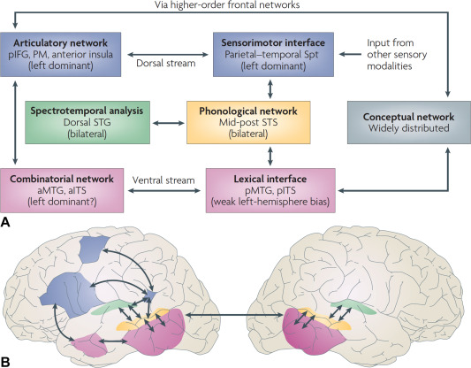
The Neuroscience of Language
The Dual-Stream Architecture in Detail
Two interacting pathways, one integrated system
Dorsal stream: sound to articulation
Ventral stream: sound to meaning
Notes:
The dual-stream model provides a modern blueprint for how language is organized in the brain.
The ventral stream, running from auditory cortex to anterior and middle temporal regions,
supports comprehension—it maps sounds to meaning.
It is largely bilateral, explaining why understanding can survive left-hemisphere damage.
The dorsal stream, linking posterior temporal and inferior parietal regions to premotor and inferior frontal areas,
is more left-lateralized and supports production—mapping sounds to articulatory plans.
Information flows both ways through these pathways.
The dorsal stream not only translates perception into action but also uses motor predictions to shape perception,
a key principle in predictive coding.
Meanwhile, the ventral stream integrates auditory input with semantic and contextual knowledge,
grounding words in conceptual representations.
Together they form a dynamic feedback system that supports speech, comprehension,
and verbal working memory in real time.
This architecture replaces the “two boxes and a wire” of the classical model
with two flexible, interactive networks.
It explains why speech perception, imitation, and production activate overlapping brain regions.
It also accounts for how children and adults learn new words
—by linking phonological forms to both articulatory and conceptual networks.
The dual streams provide a structural scaffold that can support both symbolic and learning-based processes.
Still, even this model has limits.
Its regions are defined by anatomy, not necessarily by their functional specialization.
Many show activation for nonlinguistic tasks, and connectivity varies across individuals.
To move beyond anatomy, researchers have begun defining the core language network functionally
—an effort that has transformed how we study language in the brain.
That shift is the focus of our next slide.

Slide 12
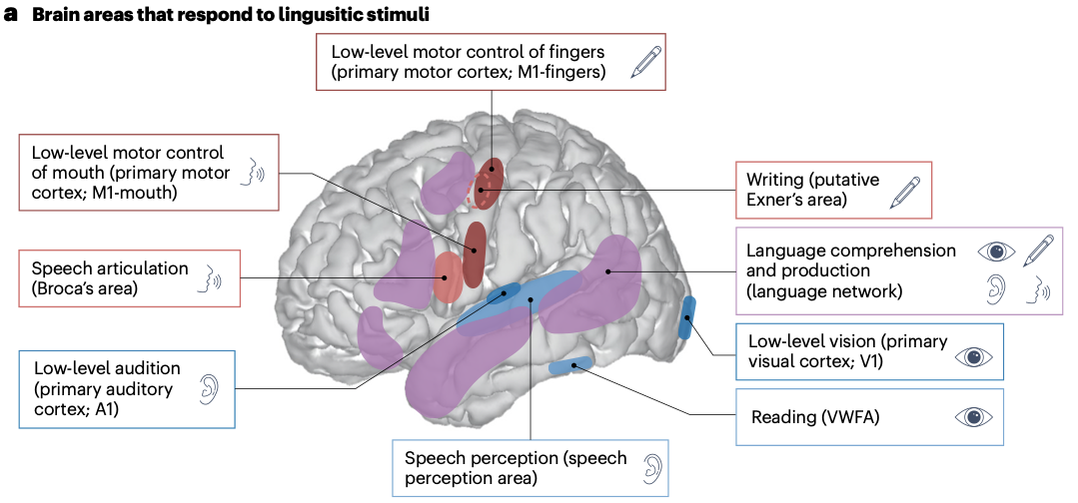
The Neuroscience of Language
The Core Language Network
A functionally defined network for language
Frontal and temporal regions act together
Selective for sentences, not just sound or memory
Notes:
Recent work by Evelina Fedorenko and colleagues has redefined how we map language in the brain.
Instead of relying on anatomical landmarks or group averages,
they identify the core language network in each individual using functional localizers.
Participants read or listen to sentences versus meaningless word lists;
areas responding selectively to coherent language are mapped per person.
This approach consistently reveals a left-lateralized network spanning frontal (inferior frontal gyrus and middle frontal gyrus)
and temporal (superior and middle temporal gyri, anterior temporal cortex) regions.
These areas are language-selective—they activate for sentences
but not for nonlinguistic working memory, math, or music.
They respond similarly across comprehension and production,
suggesting a shared representational system for linguistic structure.
Connectivity analyses show that these regions form a tightly integrated network,
distinct from neighboring auditory and control systems.
This functional consistency across individuals helps explain
why earlier group-averaged maps blurred or mislocalized language regions.
The language network’s functional profile supports both sides of the long-running debate.
Its stable, selective pattern argues for some degree of specialization
—a neural infrastructure tuned for hierarchical linguistic representations.
Yet its emergence through experience and its connectivity
with domain-general systems reflect learning and plasticity
rather than hardwired modularity.
It is a system optimized for language, but built from general-purpose cortical circuits refined by use.
This modern framework replaces the old “Broca’s area” concept with a broader,
empirically grounded network.
It captures how the brain represents language as a distributed computation
spanning multiple regions and modalities.
Next, we’ll look at how this system interfaces with other large-scale networks
that support control, attention, and meaning.

Slide 13
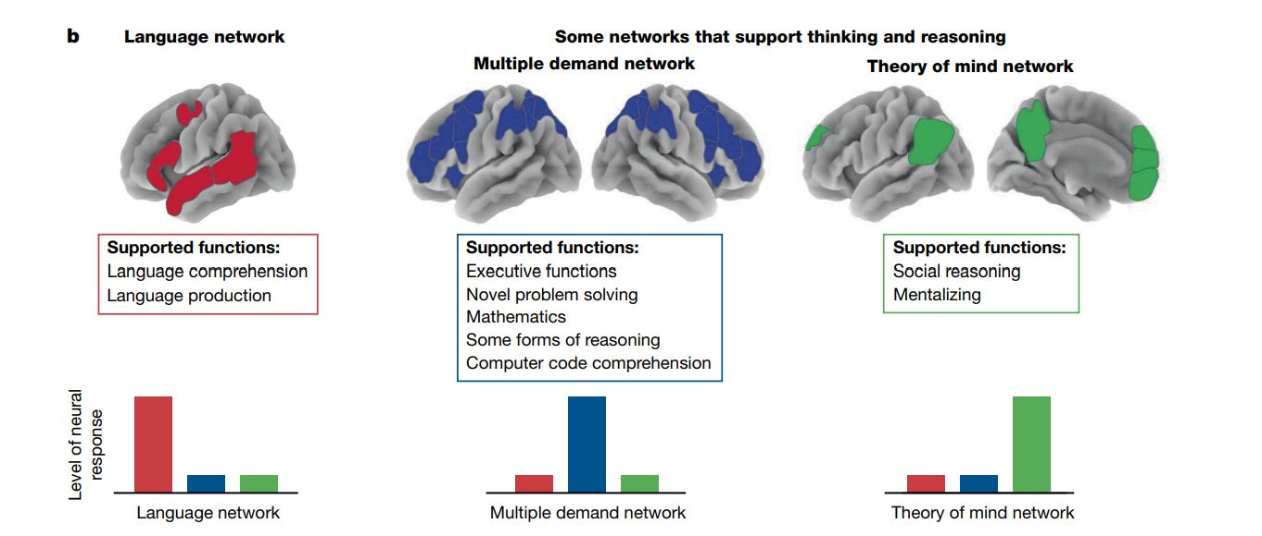
The Neuroscience of Language
Domain-Specific vs. Domain-General Systems
Language network, control network, and meaning network
Selective specialization meets flexible coordination
The brain balances focus with integration
Notes:
Fedorenko’s work shows that the core language network operates alongside
other large-scale systems rather than in isolation.
Adjacent to it lies the multiple-demand network (MDN)
—a set of frontal and parietal regions recruited for
demanding cognitive control, attention, and problem-solving.
Another nearby system, the default-mode network (DMN), supports memory, mental simulation,
and conceptual meaning.
Language processing engages with both: the MDN for effortful comprehension and planning,
and the DMN for constructing rich, world-based semantics.
This spatial and functional relationship reframes how we think about modularity.
The language network appears highly selective: it activates for linguistic structure
but not for math or spatial reasoning.
The MDN, by contrast, is domain-general—it scales with task difficulty across many kinds of content.
The DMN is introspective and conceptual, integrating language with memory and imagination.
During natural language comprehension, all three networks interact,
oscillating in strength depending on context and demand.
For the symbolic view, the core language network looks like evidence
of a dedicated computational system
—a possible neural home for rule-based structure building.
For the learning-based and connectionist view, its cooperation with MDN and DMN
highlights shared circuitry and adaptive reuse.
Experience may tune these general circuits to become increasingly specialized for linguistic input,
explaining both universality and individual variability.
The emerging consensus is that language is both specialized and connected.
It relies on a stable cortical network for structure and syntax,
but continually recruits neighboring systems for control, inference, and meaning.
This blended organization echoes the hybrid cognitive story we saw last time:
structured representations shaped by learning and prediction.
Next, we turn to how neuroscience captures not just where these processes happen
—but when they unfold in real time.

Slide 14
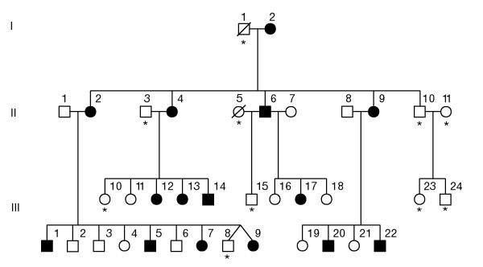
The Neuroscience of Language
Comparative Vocal Learning and FOXP2
Other species imitate; few can truly learn to speak
Vocal learning links communication to motor learning
FOXP2 offers a genetic window—but not a “language gene”
Notes:
Language did not appear fully formed—it built on older systems for sound and movement.
A few animal groups show true vocal learning, the ability to modify sounds through experience:
songbirds, parrots, whales, bats, and humans.
Each has evolved specialized loops linking auditory and motor areas,
allowing imitation and feedback-based refinement.
These convergent adaptations suggest that speech arose from general-purpose circuits
for sequential motor learning.
The FOXP2 gene provides one clue to this transition.
In the early 1990s, scientists identified a large British family—known as the KE family
—in which about half the members had strikingly similar
speech and language impairments.
They could understand normal conversation, but struggled with fluent articulation,
word endings, and grammatical inflections, despite otherwise normal cognition.
Genetic analysis revealed that all affected members shared a mutation in the FOXP2 gene,
marking the first clear genetic link to a speech disorder.
This discovery, published in 2001, helped open a new field of research
on the molecular basis of vocal and motor learning.
Subsequent research has shown that FOXP2 is not a “language gene.”
It regulates hundreds of downstream genes affecting motor control, neural plasticity,
and developmental timing across many brain systems.
Its role is permissive rather than specific—it supports the neural flexibility
and sequencing capacity that language depends on,
but does not encode grammar or speech itself.
In humans, it contributes to the broader ability to learn and refine complex action patterns,
of which spoken language is one remarkable example.
In other species, FOXP2 plays similar roles in learning and motor sequencing.
In songbirds, its expression rises during song learning and falls once songs are crystallized,
suggesting a role in fine-tuning vocal imitation.
In mice and bats, it influences the development of vocalizations and the timing of movement sequences.
Across taxa, FOXP2 seems to govern circuits that support precise, learned motor behaviors,
whether those are songs, calls, or speech—highlighting how evolution repurposed
a shared molecular toolkit for different communicative ends.
This perspective helps reconcile biological and cultural accounts of language evolution.
Genes like FOXP2 make learning complex sequences possible.
Learning and communication then feed back to shape the brain across generations.
Vocal learning sits at this intersection—where biology provides the capacity,
and culture provides the content.
With that foundation, we can now turn to how the human brain organizes
the functions of comprehension and production.

Slide 15
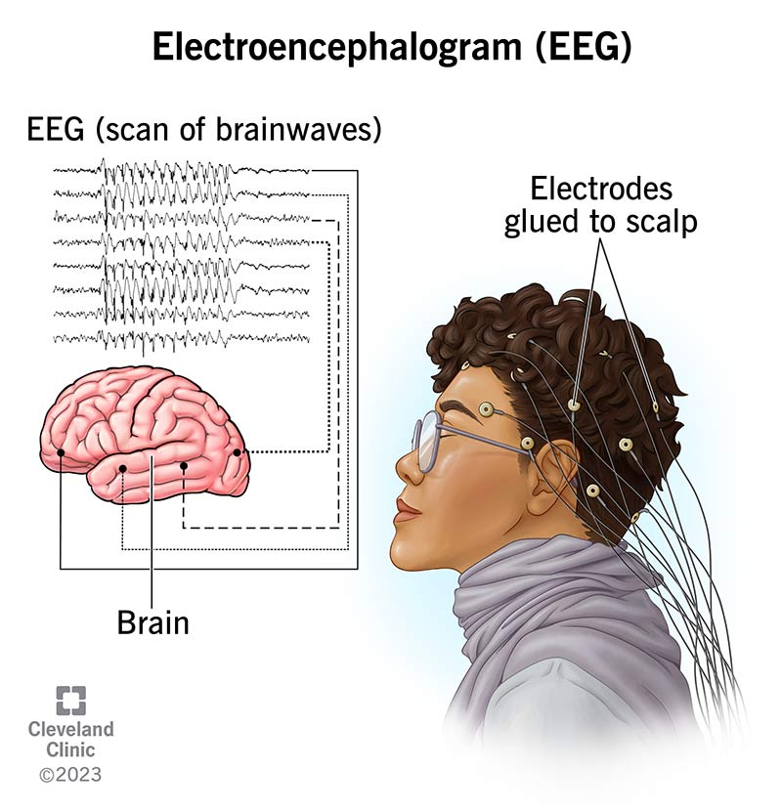
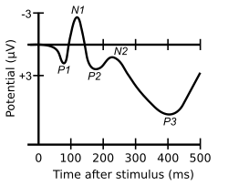
The Neuroscience of Language
Methods: EEG and ERP Basics
Measuring the brain in time, not space
ERPs track processing millisecond by millisecond
Revealing how comprehension unfolds in real time
Notes:
While fMRI shows where language happens, EEG and event-related potentials (ERPs) show when.
Electrical signals recorded from scalp electrodes reveal the brain’s rhythmic responses
to each word, sound, or symbol.
By averaging across many trials, we can see characteristic voltage patterns
—tiny deflections in time—linked to specific cognitive events.
This method captures neural activity with millisecond precision, matching the speed of language comprehension itself.
ERPs have become one of the most powerful tools in psycholinguistics.
Because language is fast and incremental, meaning and structure are processed as each word arrives.
ERPs let researchers trace those processes dynamically: prediction, surprise, reanalysis,
or integration can each leave distinct temporal fingerprints.
These signals are small but reliable, allowing comparisons across individuals, languages,
and developmental stages.
Typical ERP components are named for their polarity (negative or positive)
and their timing in milliseconds.
For example, an “N400” is a negative deflection around 400 ms after a stimulus;
a “P600” is a positive one around 600 ms.
Different components reflect different types of processing
—semantic, syntactic, attentional, or error-related.
By combining timing data with localization from imaging,
we can map not only where but when each linguistic operation occurs.
This approach has revolutionized our understanding of comprehension.
It shows that language understanding is not a single moment of “meaning”
but a continuous cascade of predictions and adjustments.
Next, we’ll examine two of the most studied signatures in all of cognitive neuroscience:
the N400 and the P600, and how they illuminate the balance between structure and learning.

Slide 16
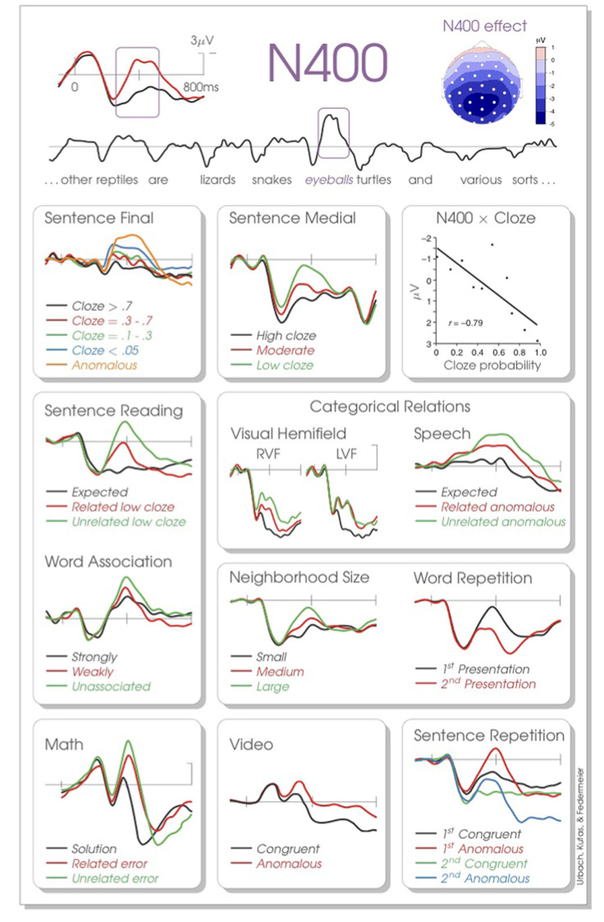
The Neuroscience of Language
The N400: Meaning, Memory, and Prediction
A window into comprehension in real time
Prediction and meaning draw on memory
The brain prepares before words arrive
Notes:
The N400 is one of the best-studied brain responses in cognitive science
—a negative-going wave peaking around 400 milliseconds after a meaningful stimulus.
Traditionally seen as a sign of semantic integration,
it grows larger when a word doesn’t fit its context,
as in “He spread the warm bread with socks.”
But as Federmeier (2021) emphasizes, the N400 reveals much more than surprise.
It reflects the activation of meaning before the input appears
—a record of the brain’s continuous effort to predict and prepare.
ERP evidence shows that the N400 draws on long-term memory systems
to pre-activate likely meanings, features, and associations.
This activity arises from multiple levels of constraint—lexical, syntactic, and conceptual.
For example, context about who is speaking, what is happening,
or where the story takes place can all reduce N400 amplitude,
even before the critical word is heard.
In Federmeier’s view, comprehension is not a stepwise decoding of words
but an ongoing coordination of memory and prediction.
The N400 also blurs the line between language and general cognition.
Similar prediction effects appear for pictures, gestures, and environmental sounds,
showing that the underlying system is domain-general.
Language simply leverages it for rapid meaning construction,
making comprehension part of a broader predictive brain architecture.
Thus, the N400 provides evidence that linguistic understanding is grounded in general mechanisms of expectation, memory retrieval, and associative learning.
For the broader debate, the N400 supports a learning-based,
predictive view of comprehension.
It shows that meaning emerges through graded activation of possibilities,
not rigid rule application.
Yet structure still constrains these predictions—grammar and context guide what can be expected.
Together, these findings position the N400 as a bridge between symbolic and connectionist theories:
a neural signature of how experience-based learning gives rise to structured understanding.

Slide 17
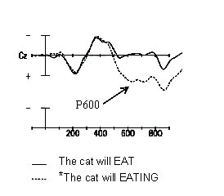
The Neuroscience of Language
The P600: Reanalysis and Adaptation
A signal of surprise and repair
Syntax, semantics, or conflict?
The brain’s model-updating response
Notes:
The P600 is a late positive-going ERP that peaks around 600 milliseconds
after a stimulus and often follows syntactic or interpretive violations.
Classic examples include sentences like “The child throw the toy,” which lacks agreement,
or “The boat sailed the sailor,” which reverses expected roles.
Early studies saw the P600 as a “syntax repair” signal—a sign that the brain was rechecking grammatical structure after an error.
But newer work shows that the P600 reflects a broader process: reanalysis and adaptation.
Rather than indexing syntax alone, the P600 appears whenever
the comprehension system’s predictions fail and a model must be updated.
It emerges for syntactic anomalies, garden-path sentences, and even semantic incongruities that require reinterpretation.
For instance, “The hearty meal was devouring the kids” elicits both an N400 and a P600
—the first for implausibility, the second for attempting to revise the interpretation.
This suggests that the P600 represents the brain’s flexible mechanism for reconciling conflict between expectation and input.
Most erp researchers argue that the N400 and P600 form a complementary pair within an adaptive comprehension system.
The N400 tracks proactive prediction—how prepared the brain was for what it encountered.
The P600 tracks reactive updating—how much revision or restructuring is needed when predictions break down.
Together they reveal comprehension as a dynamic cycle of anticipation, evaluation,
and repair, continuously shaping a coherent mental model.
This reinterpretation also speaks to the symbolic versus learning debate.
The P600 reflects a kind of rule-based reanalysis, consistent with symbolic accounts of structure building.
Yet its flexibility and domain-generality show that even “rule checking”
emerges from broader neural mechanisms of prediction error and adaptation.
In the next slide, we’ll see how these two signals—N400 and P600
—work together to make comprehension both structured and adaptive.

Slide 18
The Neuroscience of Language
Prediction
Input
Error Signal / Processing Difficulty (N400)
Model Update (P600, LFP)
Integrating the Signals: Prediction and Reanalysis
Comprehension is continuous, not discrete
The brain anticipates, evaluates, and revises
Prediction and repair form one adaptive loop
Notes:
Taken together, the N400 and P600 reveal that understanding language is not a single event
—it’s a continuous balancing act.
The brain predicts upcoming words, meanings, and structures, t
hen constantly checks and revises those expectations.
When predictions succeed, processing flows smoothly and efficiently.
When they fail, the system recruits new resources to rebuild coherence.
Federmeier describes this as an adaptive comprehension system: the brain learns from its own prediction errors.
These two ERP components track distinct but intertwined stages of this loop.
The N400 reflects proactive prediction—semantic and contextual pre-activation based on memory and experience.
The P600 reflects reactive adaptation—reanalysis or restructuring when the prediction proves wrong.
In natural comprehension, they often overlap, showing that the mind doesn’t wait for full failure before adjusting.
This interplay allows flexible, resilient understanding even in noisy or ambiguous input.
Together, they bridge perspectives that once seemed opposed.
Symbolic theories emphasize structure and rules; learning-based theories emphasize prediction and adaptation.
The neural evidence shows both are operating at once—hierarchical structure constrains what can be predicted,
while prediction errors reshape those structures over time.
Comprehension, in other words, is an ongoing dialogue between rule and experience.
The N400 and P600 thus embody the core principle of this lecture:
language is implemented in brain systems that are predictive, plastic, and structured at once.
They connect cognitive theories to neural timing, demonstrating how experience-based learning
supports the structured representations required for meaning.
Next, we’ll turn from real-time signals to the long-term organization of those systems
—their specialization, plasticity, and resilience.

Slide 19
The Neuroscience of Language
Bilingualism and the Language Brain
Two languages, one network
Shared circuits with dynamic control
Flexibility without duplication
Notes:
The human brain can manage multiple languages within largely the same neural infrastructure.
Imaging studies show that bilinguals recruit the same core language network—left inferior frontal and temporal regions—for both languages, with subtle shifts depending on proficiency and age of acquisition.
Rather than building a separate circuit for each tongue, the brain stores overlapping representations and modulates which is active moment by moment.
This coordination relies on both language-selective and domain-general control systems.
During code-switching or translation, frontal and parietal regions of the multiple-demand network (MDN) help select the target language and inhibit the other.
Fluent bilinguals do this automatically, showing rapid switching without loss of comprehension.
Late bilinguals or less proficient speakers engage these control regions more strongly, reflecting the effort of maintaining separation within shared neural space.
The degree of overlap depends on when and how languages are learned.
Early bilinguals—exposed to both languages from infancy—show nearly complete neural overlap, with shared phonological and syntactic representations.
Late learners retain distinct patterns, especially for grammar and articulation, yet comprehension still recruits common temporal circuits.
This gradient highlights how experience shapes the brain’s linguistic flexibility within a conserved architecture.
Bilingualism reveals that language lateralization is adaptable, not fixed.
Both languages rely on left-dominant perisylvian systems, but the right hemisphere contributes more when control or context demands increase.
The ability to fluidly integrate two symbolic systems without confusion demonstrates the resilience of the language network—and how cultural learning can sculpt it in new directions.
Next, we’ll see how this flexibility extends across modalities, in the case of signed languages.

Slide 20
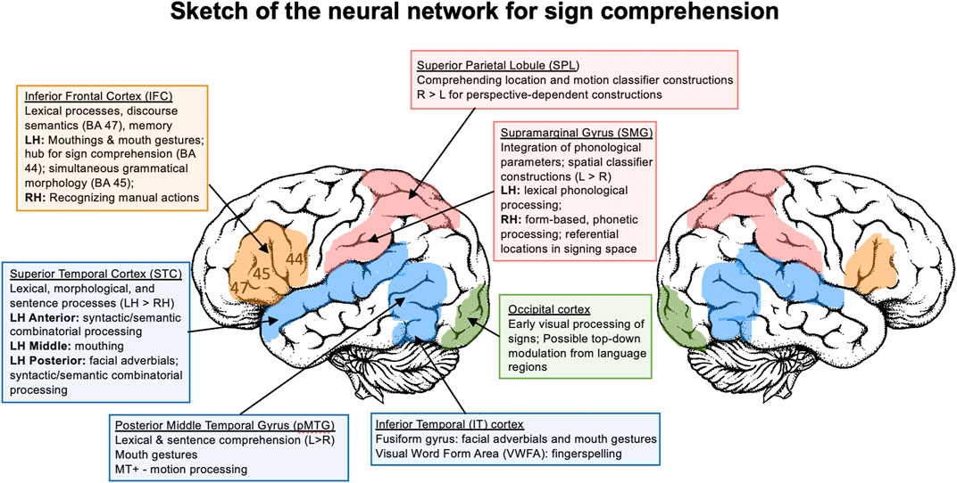
The Neuroscience of Language
Signed Languages and Modality Independence
Different channels, same architecture
Structure over surface
Language transcends speech
Notes:
Signed languages offer one of the strongest tests of what language is at the neural level.
They use gesture and space instead of sound and time, yet they share every key property of spoken language
—hierarchical structure, morphology, and syntax.
If language were simply a motor or auditory skill, signers should use different brain systems.
But imaging, lesion, and electrophysiological studies show the opposite:
sign languages recruit the same left-lateralized language network used for speech.
Damage to Broca’s or Wernicke’s homologues in deaf signers produces expressive and receptive aphasias
nearly identical to those in speakers.
Fluent signers show activation in the left inferior frontal and posterior temporal regions,
with additional recruitment of parietal and visual–motion areas to manage spatial relationships.
These findings confirm that the brain’s “language” machinery is defined by abstract combinatorial structure,
not by sound, writing, or gesture.
Sign language also illuminates how modality shapes representation without changing the core system.
Spatial grammar and classifier constructions draw on visual
–motor circuits, but they are governed by the same hierarchical rules as spoken syntax.
This shows that the language network is flexible in input and output, but constant in its internal logic.
Even when hands replace tongues, the brain parses and produces linguistic structure in the same way.
By demonstrating modality independence, sign languages underscore a central theme of this lecture:
language is an abstract computation realized through diverse biological channels.
Its universality lies not in the muscles or senses it uses, but in the predictive, hierarchical patterns it implements.
In our final slide, we’ll return to the larger story of how those patterns evolved—from action, to simulation, to thought.

Slide 21
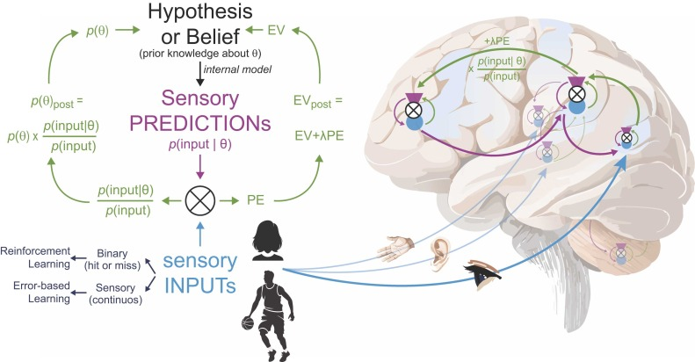
The Neuroscience of Language
Predictive Coding and the Evolution of Inner Simulation
From movement to mind
From simulating actions to simulating meaning
Prediction as the unifying principle
Notes:
Throughout this course, we’ve traced a deepening capacity for mental simulation.
Early mammals evolved the ability to internally model their own movements—predicting the sensory consequences of each action before taking it.
Primates extended this ability to simulate others, building the foundations for empathy, imitation, and theory of mind.
That same power to imagine and compare possible futures became the raw material for symbolic thought and language.
Language may be the brain’s most refined form of simulation.
Each word we hear activates expectations about what might come next—sounds, meanings, and actions—before they arrive.
This is the essence of predictive coding: the brain constantly generates hypotheses and corrects them with new evidence.
Understanding language is not passive decoding; it’s an active process of forecasting and updating, a conversation between expectation and surprise.
Seen in this light, linguistic prediction is part of a larger evolutionary story.
The circuits that once guided reaching and grasping now help anticipate syntactic structure and semantic coherence.
Neural loops that once tracked the intentions of others now help track the unfolding logic of a sentence.
Speech comprehension becomes a kind of social simulation—our brains rehearsing, in miniature, the minds behind the words.
This view unites our three levels of analysis.
At the functional level, prediction makes behavior more efficient and flexible.
At the algorithmic level, it explains how probabilistic models generate structured expectations.
And at the implementational level, it links perception, action, and meaning through shared neural dynamics.
Language is not an exception to the brain’s design—it is its culmination: a system for communicating and refining internal models of the world.

Slide 22
The Neuroscience of Language
Summary
Language as prediction, simulation, and structure
Evolved from action, refined by culture
Bridges biology, cognition, and meaning
Next Time
Symbolic thought and human culture
Notes:
Across these three lectures, we’ve traced how language emerged, how it works, and how it lives in the brain.
At the functional level, we saw its roots in communication and cooperation
—an adaptation that built on primate social cognition and cultural learning.
At the algorithmic level, we explored competing theories: symbolic rules versus learning and prediction,
and found that both describe parts of a single system.
And at the implementational level, we saw how those processes are realized in distributed, predictive,
and lateralized networks of the human brain.
Language did not arise suddenly or in isolation.
It evolved from the brain’s older abilities to simulate actions, anticipate outcomes, and model other minds.
Each innovation—gesture, speech, teaching, storytelling
—turned internal simulation outward, linking thought to shared meaning.
What began as the ability to predict a movement became the ability to predict a mind,
and then to communicate those predictions through symbols.
Neuroscience shows that language remains both specialized and flexible.
It is grounded in left-hemisphere circuitry yet shaped by experience, capable of reorganizing
after injury or across modalities.
It unites the predictive mechanisms we’ve seen throughout this course—motor control, perception, memory
—into a single integrative function: communication as coordinated imagination.
Next week, we extend this story beyond words.
We’ll ask what happens when symbols leave the domain of language
—when they become tools for reasoning, abstraction, and science itself.
In short, we’ll move from language as communication to language as thought: the dawn of symbolic cognition.

